Slide 1
1.1 Common problems with usability
Addressing Usability problems through various role in User Interface Design

Slide 2
Usability
Usability is about ensuring that your website is easy to learn, effective to use and enjoyable for your target audience.
User interface (UI) software is often large, complex, and difficult to implement, debug, and modify. As interfaces become easier to use, they become harder to create [Myers 1994].

Slide 3
Usability
Jakob Nielsen suggests that there are five aspects of usability:
Ease of learning
Efficiency of use
Memorability
Error frequency and severity
Subjective satisfaction

Slide 4
Usability
User-centered design user-centered design approach: is based on knowledge of your website's potential users and their:
Technological capacities
Physical capacities
Cultural context
Information needs

Slide 5
Common Usability Problems
The inability to quickly locate information on a web site
Getting lost or stuck in a site
Inability to properly view page content or parts of it
Page difficult to print
Slow page download times

Slide 6
1.The inability to quickly locate information on a web site
Problem locating information
Philosophy in Cyberspace
Too many steps required to navigate
Poorly named navigational aids
All About Lawns
Inconsistent search engine placement
Search results

Slide 7
1.The inability to quickly locate information on a web site
Problem: the inability to quickly locate information on a web site
Likely cause(s):
(a) badly-designed navigation
(b) site architecture inappropriate
(c) no readily-accessible search facility
(d) poor page layout/use of screen real estate
(e) broken link(s)
(f) out of date information

Slide 8
2. Getting lost or stuck in a site
(2) Problem: getting lost or stuck in a site Likely cause(s):
(a) badly-designed navigation
(b) no site location indicators on pages
(c) orphan pages (no internal links)
(d) broken back button on browser
(e) opening unnecessary browser windows

Slide 9
3. Inability to properly view page content or parts of it
(3) Problem: inability to properly view page content or parts of it Likely cause(s):
page not cross-platform/cross-browser compatible
page not authored to web accessibility (WAI) standards
page not designed to 'degrade gracefully' in older browsers
page design does not take account of different monitor resolutions
HTML markup does not conform to standards
reliance on non-present client-side technology browser plug-ins)
faulty or inappropriate use of client-side technology

Slide 10
4. Page difficult to print
Problem: page difficult to print Likely cause(s):
fixed page width too wide
inappropriate use of background colours/images
graphics used as text

Slide 11
5. Slow page download times
Problem: slow page download times Likely cause(s):
(a) gratuitous use of graphics and/or multimedia
(b) failure to optimize graphics
(c) too much content on one page

Slide 12
User experience careers
Interaction designers focus on designing the experience of a product and how it functions.
They strive to understand the user flow, or the path, that a typical user takes to complete a task on an app, website, or other platform.
At Google and many other companies, interaction designers are a specialized type of UX designer.

Slide 13
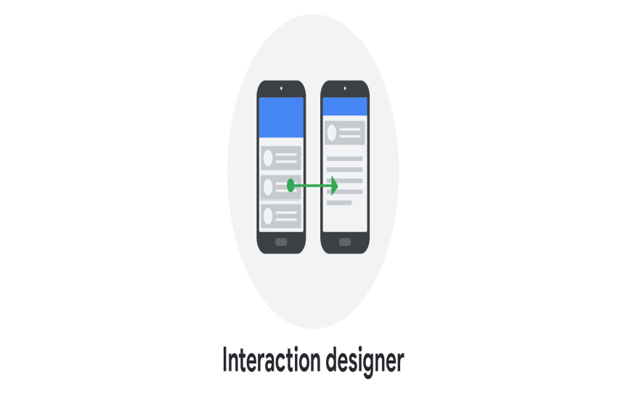
User experience careers
An interaction designer's work answers questions like:
What should happen if a user taps on this button?
How do we make this action easier for users to complete?
And, how are the design elements within the website laid out?
Interaction designers focus less on how the product looks and instead strive to make the product easy to navigate and simple for users to interact with.

Slide 14
User experience careers
Visual designers focus on how a product or technology looks.
They are often responsible for designing logos, illustrations, and icons, as well as deciding on font color, size, and placement.
Visual designers focus on the layout of each page or screen and make all of the design elements fit together in a visually appealing way.
At Google and many other companies, visual designers are a specialized type of UX designer.

Slide 15
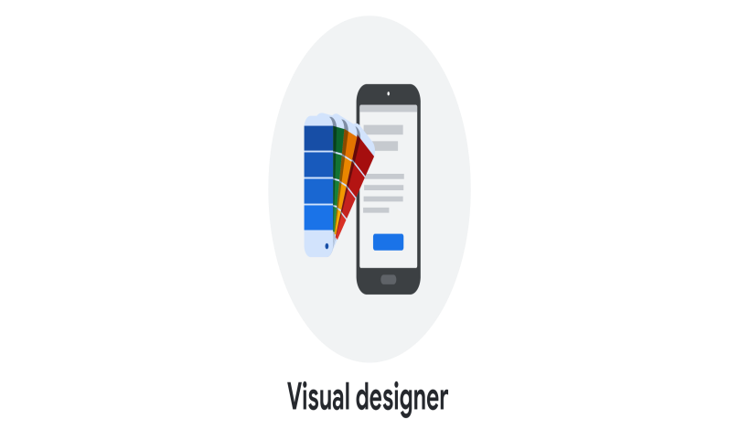
User experience careers
The role of a visual designer is to answer questions like:
What kind of visual style should icons have, in order to fit the product's branding?
Or, which color and font should we use for this button?
The goal of a visual designer is to delight users with designs that inspire, engage, and excite them.

Slide 16
User experience careers
Motion designers think about what it feels like for a user to move through a product and how to create smooth transitions between pages on an app or website.
They may also create animations or visual effects to bring their design ideas to life.
At Google and many other companies, motion designers are a specialized type of UX designer.

Slide 17
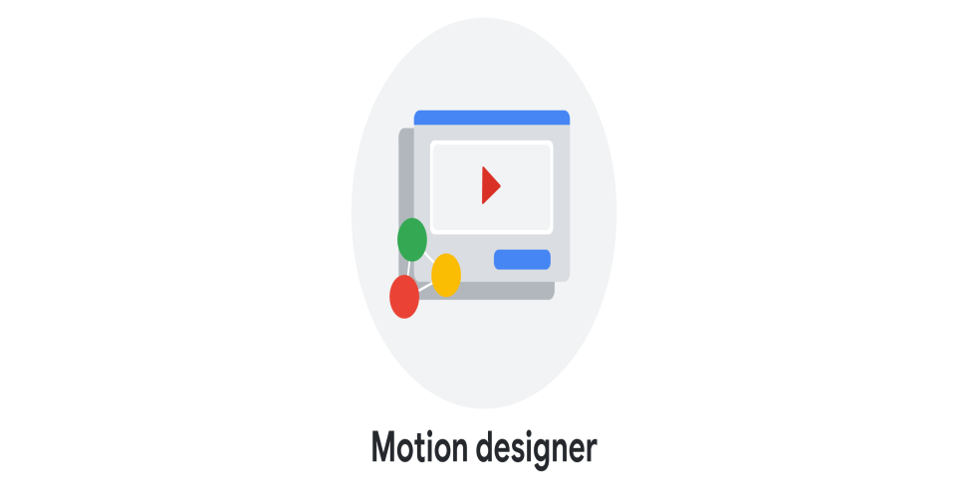
User experience careers
A motion designer’s work answers questions like:
How should an app transition between pages?
How do we show the connection between these actions?
And, what’s an engaging animation that will help tell our story?
Motion designers focus on design elements that move, rather than traditional static designs.

Slide 18
User experience careers
Virtual reality (VR) and augmented reality (AR) designers create products that provide users with immersive experiences, unbounded by the limits of the physical world.
Virtual reality involves a wearable headset that takes over a user’s vision; it blocks out their physical surroundings and immerses them in a completely virtual world.
For example, VR can feel like you're entering the setting of a magical imaginary land.

Slide 19
User experience careers
On the other hand, augmented reality uses the physical world as a backdrop and adds virtual elements on top of it.
Users are still contextually aware of their surroundings, but their reality is augmented, or enhanced, by adding elements through a screen.
For example, you can sit in your actual kitchen, and an AR experience can add digital images, like a new barstool or a piece of artwork, to the room around you.

Slide 20
User experience careers
A VR or AR designer’s work answers questions like:
How do we create a user experience that leverages 3D space?
Or, will this action cause a user motion sickness?
To ensure users are comfortable immersing in a VR or AR experience, designers need to carefully consider everything from sound to lighting.

Slide 21
User experience careers
UX researchers conduct studies or interviews that examine how people use a product.
UX researchers often identify pain points that users are experiencing and explore how products can help solve those problems.
They also explore the usability of existing products, by asking users to complete tasks in an app or website, for example.

Slide 22

User experience careers
UX researchers answer questions like:
What problems are users facing?
Is the design of this product easy to use?
And, would people be interested in this new design feature?
The goal of UX researchers is often to understand how a product can provide a solution to a real problem users are having.

Slide 23
User experience careers
UX writers think about how to make the language within a product clearer so that the user experience is more intuitive.
UX writers also help define a brand’s voice and personality. The work of UX writers often includes writing labels for buttons and determining the tone of language used within an app or website.

Slide 24

User experience careers
UX writers focus on answering questions like:
What words should be used to communicate this idea clearly?
Should the tone for this app be friendly or technical?
And, what should the language on this button label say?
UX writers often become subject matter experts in order to present content that’s easy to understand for all users.

Slide 25
User experience careers
UX program managers ensure clear and timely communication, so that the process of building a useful product moves smoothly from start to finish.
This might include setting goals, writing project plans, and allocating team resources.

Slide 26

User experience careers
UX program managers answer questions like:
What are the overall goals for this project, and what’s the plan to achieve them?
And, how can we create and improve processes within the team?
UX program managers work across departments to make sure that UX is involved throughout a project lifecycle.

Slide 27

User experience careers
UX engineers translate the design’s intent into a functioning experience, like an app or a website.
They help UX teams figure out if designs are intuitive and technically feasible.

Slide 28
User experience careers
UX engineers answer questions like:
How do we implement each interaction?
How do we build this design in a way that stays true to its original intent?
And, how might we explore alternatives to determine the best user experience?
UX engineers synthesize design and development, bringing product concepts to life.

Slide 29
User experience careers
Conversational interfaces are everywhere, from intelligent virtual assistants like Google Assistant and Siri, to interactive voice response systems like customer service systems you can talk to.
Conversational interfaces even include automobile navigation systems and chatbots! Conversation design incorporates natural, real-world conversational behaviors into the interactions between users and these systems.

Slide 30
User experience careers
Conversation designers make it possible for users to have natural conversations to get things done.
They leverage user research, psychology, technical knowledge, and linguistics to create user experiences that are intuitive and engaging.
Conversation designers develop the “persona” or personality of the voice, as well as the flow and dialog of the interaction.

Slide 31

User experience careers
Conversation designers answer questions like:
What’s the ideal language and flow based on who users are, the task to be accomplished, and the context of the conversation?
Does the personality of the virtual assistant seem genuine, engaging, and reflective of the brand values?
How does the conversation work with on-screen elements?
Does the virtual assistant offer a consistent, usable, and useful experience end-to-end?

